Slide 1

AI/ML Pipeline – Datapipeline – CI/CD

Slide 2
AI/ML Projects
Form Group (you may choose one domain to work)
Selection of topic and assignment of responsibilities
AI/ML requirements + Group requirements
Multiple deliverables
Tentative Phases
Framing the problem
Applying ML pipeline
Integration and Deployment (cloud based included)

Slide 3

The Importance of Problem Framing in ML
What is Problem Framing?
The process of analyzing a problem to isolate individual elements needing solutions.
Helps determine technical feasibility and provides clear goals & success criteria.
Crucial for ML solutions: Directly impacts product success.
Why is it Critical for ML?
Forces a deeper understanding of both the problem and the available data.

Slide 4

High-Level Steps of ML Problem Framing
Two Distinct Phases:
Determining ML Suitability:
Is Machine Learning the appropriate approach for this specific problem?
Avoids wasted effort on non-ML amenable problems.
Framing in ML Terms:
Once ML is deemed suitable, define the problem in a way that an ML model can understand and address (e.g., classification, regression, clustering).
Sets the stage for data preparation, model selection, and training.

Slide 5
Check Your Understanding
Why is problem framing important?
1. Problem framing helps diagnose problems with existing ML models and uncovers issues with data.
2. Problem framing ensures that an ML approach is a good solution to the problem before beginning to work with data and train a model.

Slide 6
The Cost of Skipping Problem Framing
Wasted Resources: Investing time, money, and effort into building an ML solution for a problem where ML isn't the best fit.
Poor Performance: Even if ML is somewhat applicable, an ill-framed problem leads to models that are ineffective or don't meet user needs.
Scope Creep & Delays: Lack of clear goals and success criteria can lead to endless iterations and project stagnation.
Dissatisfied Users: The "solution" doesn't actually solve the core user pain point.
Re-work: Often, you'll end up going back to the drawing board anyway, costing even more.

Slide 7







Your Toolkit:
Define the Business Goal: Start with the "why" – what business outcome are you trying to achieve?
Understand the User: Talk to users, understand their workflows and challenges.
Explore Alternatives: Seriously consider non-ML solutions first. Is a simple rule-based system or a database query enough?
Identify ML Task Type: If ML is suitable, categorize it (e.g., classification, regression, clustering, recommendation).
Determine Input & Output: What data goes in, and what should the model produce?
Establish Metrics: Define specific, measurable success metrics (e.g., accuracy, precision, recall, RMSE, business KPIs).
Identify Data Sources: Pinpoint where you'll get the data and assess its quality and availability.

Slide 8
Framing Problem
You frame a problem in ML terms by completing the following tasks:
Define the ideal outcome and the model's goal.
Identify the model's output.
Define success metrics.

Slide 9
Ideal Outcome and Goal
App | Ideal outcome | Model's goal
Weather app | Calculate precipitation in six hour increments for a geographic region. | Predict six-hour precipitation amounts for specific geographic regions.
Fashion app | Generate a variety of shirt designs. | Generate three varieties of a shirt design from text and an image, where the text states the style and color and the image is the type of shirt (t-shirt, button-up, polo).
Video app | Recommend useful videos. | Predict whether a user will click on a video.
Mail app | Detect spam. | Predict whether or not an email is spam.
Financial app | Summarize financial information from multiple news sources. | Generate 50-word summaries of the major financial trends from the previous seven days.
Map app | Calculate travel time. | Predict how long it will take to travel between two points.
Banking app | Identify fraudulent transactions. | Predict if a transaction was made by the card holder.
Dining app | Identify cuisine by a restaurant's menu. | Predict the type of restaurant.
Ecommerce app | Generate customer support replies about the company's products. | Generate replies using sentiment analysis and the organization's knowledge base.

Slide 10
Output Required
Models | ML system | Example output
Classification | Binary | Classify an email as spam or not spam.
 | Multiclass single-label | Classify an animal in an image.
 | Multiclass multi-label | Classify all the animals in an image.
Numerical | Unidimensional regression | Predict the number of views a video will get.
 | Multidimensional regression | Predict blood pressure, heart rate, and cholesterol levels for an individual.

Slide 11
Output Required
Model type | Example output
Text | Summarize an article. Reply to customer reviews. Translate documents from English to Mandarin. Write product descriptions. Analyze legal documents.
Image | Produce marketing images. Apply visual effects to photos. Generate product design variations.
Audio | Generate dialogue in a specific accent. Generate a short musical composition in a specific genre, like jazz.
Video | Generate realistic-looking videos. Analyze video footage and apply visual effects.
Multimodal | Produce multiple types of output, like a video with text captions.

Slide 12

Proxy Labels
Substitute for labels that aren't in the dataset.
Necessary when you can't directly measure what you want to predict.
Video Recommendation app:
can't directly measure whether or not a user will find a video useful.
A proxy label for usefulness might be whether or not the user will share or like the video.
Ideal outcome | Proxy label
Recommend useful videos. | Shared/liked

Slide 13
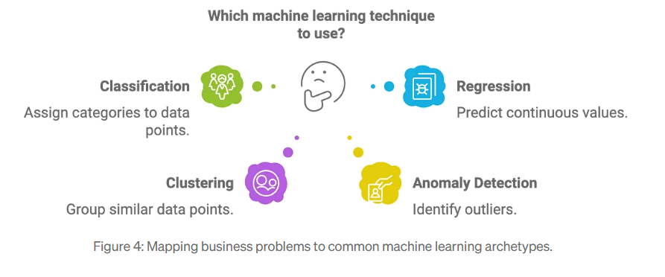
Machine Learning Models

Slide 14

Success Metrics
Define the metrics you'll use to determine whether or not the ML implementation is successful.
Success metrics define what you care about, like engagement or helping users take appropriate action, such as watching videos that they'll find useful.
Success metrics differ from the model's evaluation metrics, like accuracy, precision, recall, or AUC.

Slide 15
Example
The weather app metrics might be defined as the following:
Success | ?
Failure | ?
The video app metrics might be defined as the following:
Success | ?
Failure | ?

Slide 16
Example
The video app metrics might be defined as the following:
Success | Users spend on average 20 percent more time on the site.
Failure | Users spend on average no more time on site than before.
The weather app metrics might be defined as the following:
Success | Users open the "Will it rain?" feature 50 percent more often than they did before.
Failure | Users open the "Will it rain?" feature no more often than before.

Slide 17
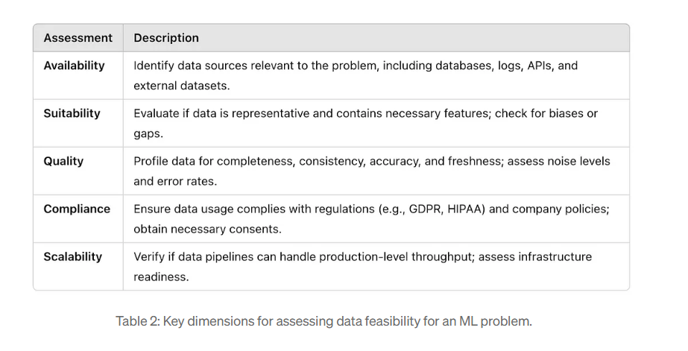
Assessing Data Feasibility Before Starting
Table source: https://medium.com/the-data-sensei/how-to-frame-machine-learning-problems-for-business-impact-a-7-step-guide-68eb89b0a25a

Slide 18

Example
A fashion firm wants to sell more clothes. Someone suggests using ML to determine which clothes the firm should manufacture. They think they can train a model to determine which type of clothes are in fashion. After they train the model, they want to apply it to their catalog to decide which clothes to make.
How should they frame their problem in ML terms?

Slide 19
Solution
Ideal outcome:
Model's goal:
Model output:
Success metrics:
Ideal outcome: Determine which products to manufacture.
Model's goal: Predict which articles of clothing are in fashion.
Model output: Binary classification, in_fashion, not_in_fashion
Success metrics: Sell seventy percent or more of the clothes made.

Slide 20
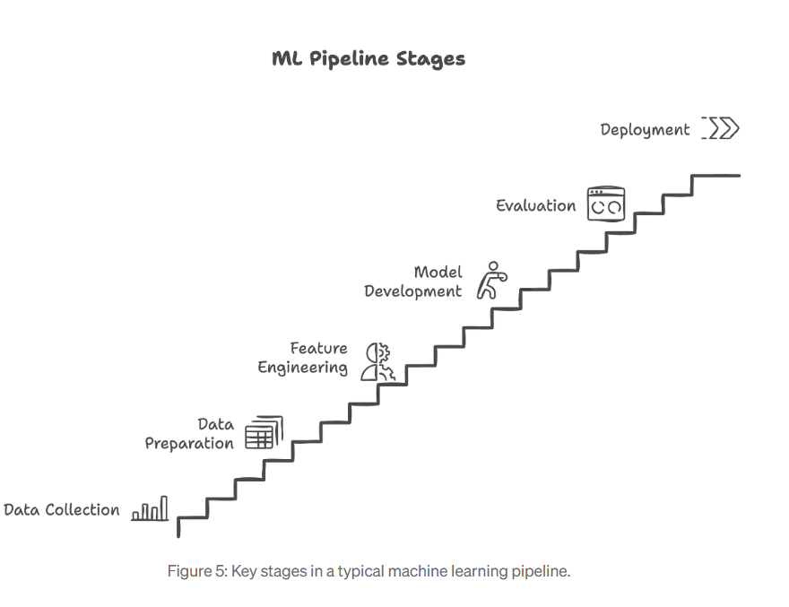
End-to-End ML Pipeline
Key Points:
Framing affects every stage of the ML pipeline:
Data Collection: Must align with business KPIs
Preprocessing: Remove irrelevant noise, engineer features based on use-case
Modeling: Prioritize interpretability/fairness if used in high-stakes areas
Evaluation: Choose business-aligned metrics (not just accuracy)
Deployment: Must fit into business systems and workflows
Monitoring: Track real-world performance; retrain regularly and Monitor Business Impact
Image source: https://medium.com/the-data-sensei/how-to-frame-machine-learning-problems-for-business-impact-a-7-step-guide-68eb89b0a25a

Slide 21
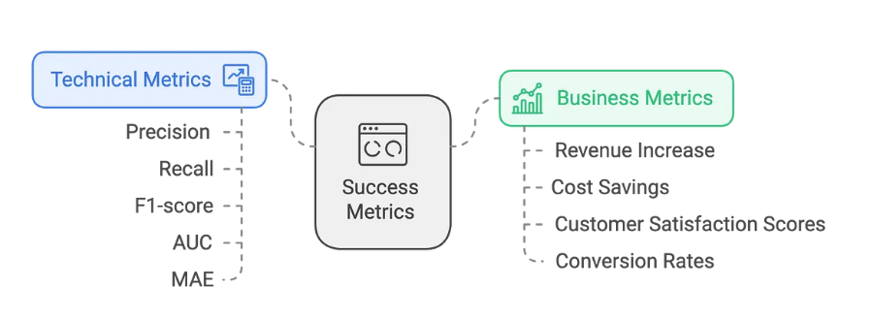
Evaluation
Image source: https://medium.com/the-data-sensei/how-to-frame-machine-learning-problems-for-business-impact-a-7-step-guide-68eb89b0a25a

Slide 22
Data Handling
Chances of missing weight data
Chances of missing weight data in older patients is higher
Chances of missing weight data due to bad weighing machine
Missing Completely at Random (MCAR) : Random and safe to drop.
Missing at Random (MAR): Depends on observed data—care needed.
MNAR (Missing Not at Random): Missing for a reason—must be modeled.
Strategies:
Deletion: Drop rows/columns with too many missing values.
Simple Imputation: Fill numeric with mean/median; categorical with mode.
Advanced Imputation: Use ML models (e.g., KNN imputation).
Missing Indicator: Add a binary column to indicate missingness.

Slide 23
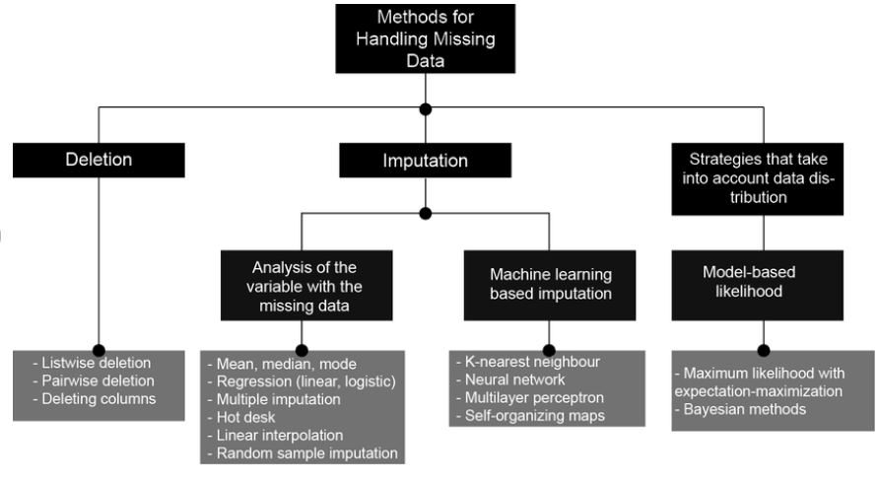
Image source: https://www.researchgate.net/figure/Strategies-for-handling-missing-data_fig1_366428246

Slide 24
Feature Engineering – Making Raw Data Meaningful
Why It’s Needed:
Models don’t understand raw timestamps or names—these need transformation.
Techniques:
Extracting time-based features: hour, day_of_week, season.
Binning numeric values: Convert Age into Age_Group.
Polynomial features: Add x², x*y for better relationships.
Log transformations to deal with skewed data.
Example: Timestamp → extract IsWeekend, TimeOfDay to understand purchase behaviors.

Slide 25
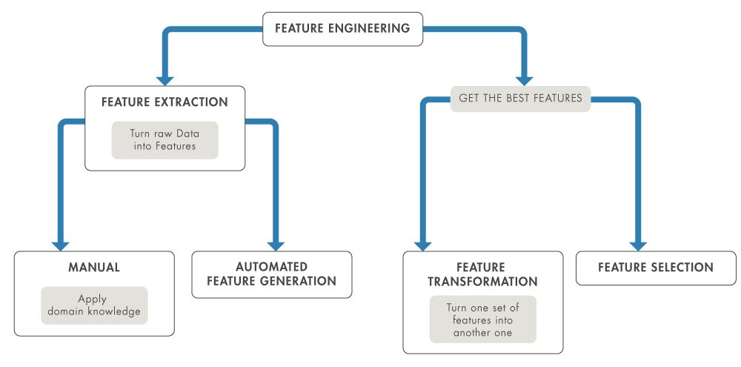
Feature Engineering – Making Raw Data Meaningful
Image source: https://www.google.com/search?q=Feature+Engineering+example+images&udm=2&sxsrf=AHTn8zo370AFsv9HQIxsoyQM3CSeryG-MQ%3A1747866290184#vhid=Kw7QPCnqEDXD7M&vssid=mosaic

Slide 26
Encoding Categorical Variables
Explanation:
ML models need numerical inputs.
One-Hot Encoding: Creates binary flags for each category.
Label Encoding: Assigns unique integers (for ordinal features).
Frequency Encoding: Replace category with how often it appears.
Target Encoding: Replace with mean of target (can leak data).
Example:
Color = [Red, Blue, Green] → One-Hot: Color_Red, Color_Blue, Color_Green.

Slide 27
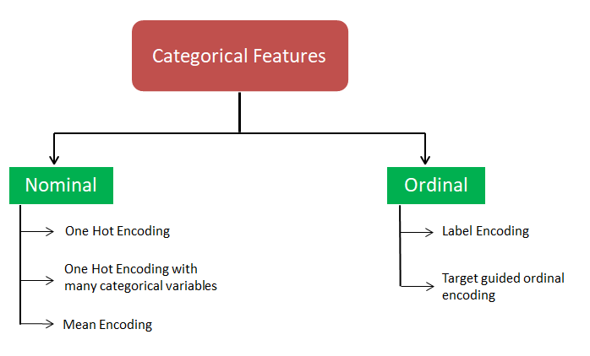
Categorical Features Types
Image source: https://medium.com/dwadda/ways-of-encoding-categorical-variables-b7a798931c8c

Slide 28
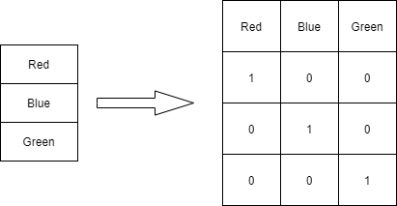
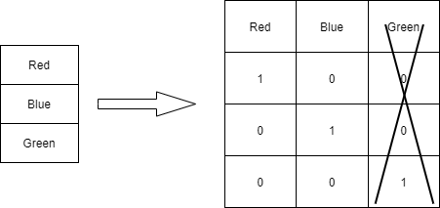
Dimensionality
No of columns for one hot encoding is n-1. where n is the number of variables

Slide 29
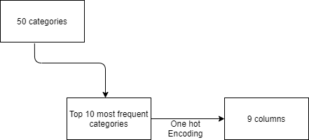
One Hot Encoding - Multicategory

Slide 30
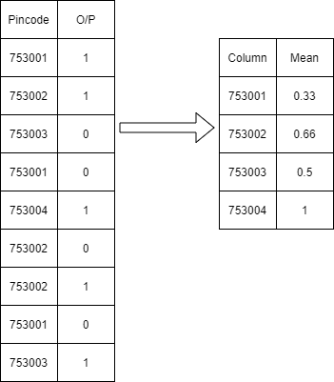
Mean Encoding

Slide 31
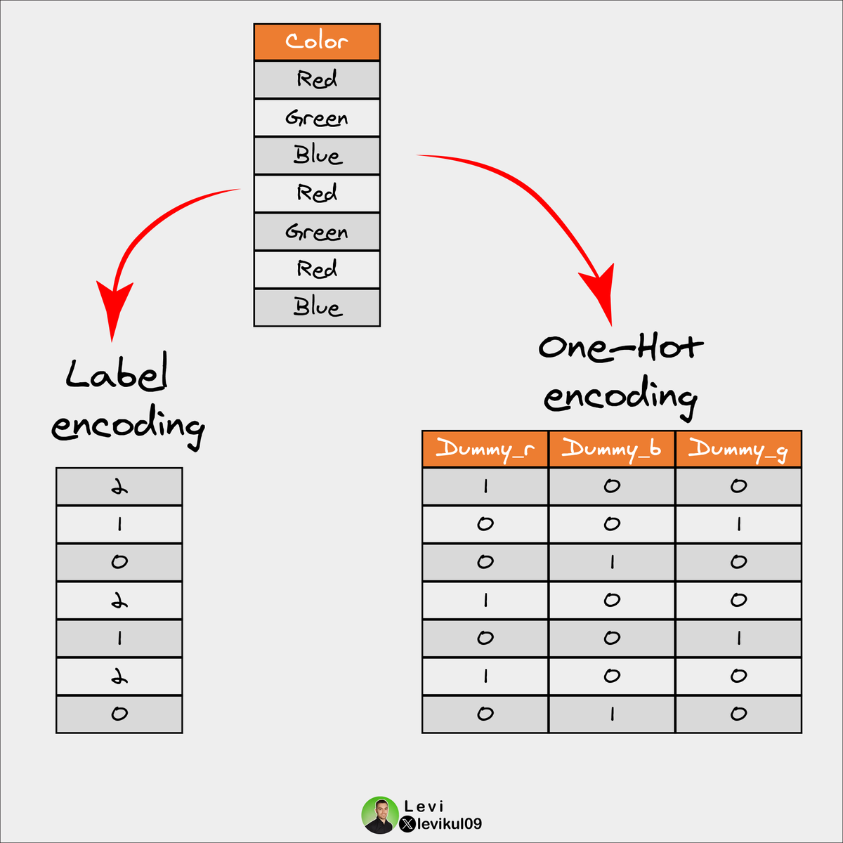
One Hot Encoding vs Label Encoding
Use One-Hot encoding for not ordinal categories and less features.
Use Label encoding with ordinal data, or where the number of categories is large.

Slide 32
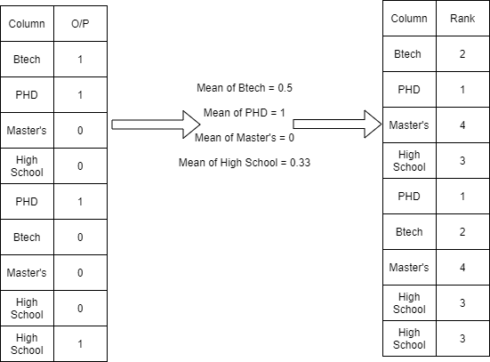
Target guided ordinal categories

Slide 33
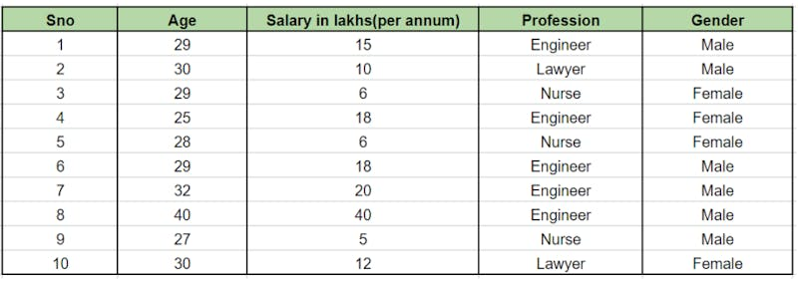
Example: Perform Encoding – Decide Type etc.

Slide 34
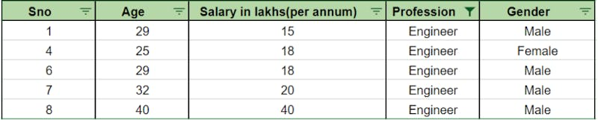

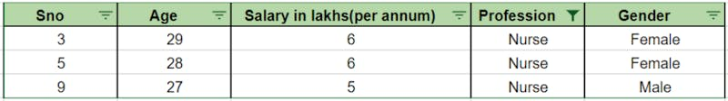
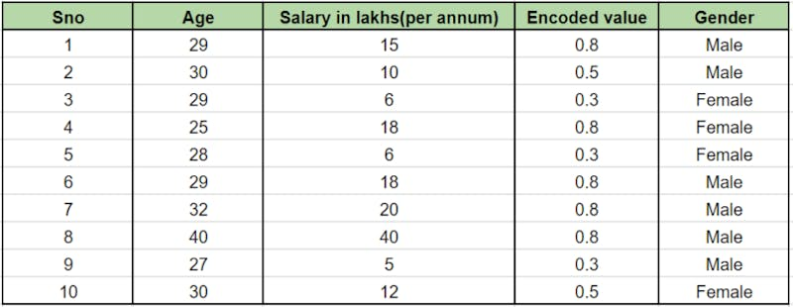
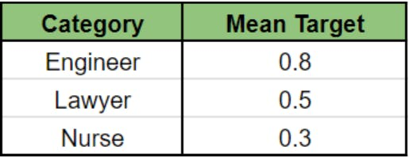
a total of 5 engineers and 4 of them are Males. consider the fraction of male class for this particular category ie ⅘ = 0.8
-
Fraction = ½ = 0.5
Fraction = 1/3 = 0.3

Slide 35
Scaling and Normalization
Explanation:
Features on different scales bias distance-based models (e.g., KNN, SVM).
Min-Max Scaling: Rescales values to [0, 1].
Z-score Standardization: Mean = 0, Std = 1.
Robust Scaling: Uses IQR—better for outliers.
Example:
In housing data, Price in $100,000s and Bedrooms in 1–5 — models give undue weight to price unless scaled.

Slide 36
Model Selection – Based on Task & Data Type
Task | Example | Models
Classification | Email Spam Detection | Logistic Regression, Random Forest
Regression | House Price Prediction | Linear Regression, XGBoost
Clustering | Customer Segmentation | K-Means, DBSCAN
NLP/Text | Sentiment Analysis | Naive Bayes, BERT
Vision/Image | Handwritten Digit Recognition | CNN, ResNet

Slide 37
What do you say…
Can you think of a real-life example where you made choices before starting a task (like setting an alarm or choosing study time)? How do those choices compare to hyperparameters in ML?
Imagine baking a cake — the recipe has oven temperature and baking time. Which do you set beforehand and which change during baking? Can you relate this to ML training?
If two students follow the same study method (algorithm) but one adjusts study hours, the other adjusts subject focus — who will perform better? What are the equivalents of these adjustments in machine learning?
Why might it be dangerous to just “guess” values for hyperparameters instead of tuning them carefully?

Slide 38
What Are Hyperparameters?
Hyperparameters are the external configurations to a model that must be set manually before training begins.
They guide the learning process but are not updated or learned during training (unlike model parameters like weights in neural networks).
Why They Matter:
Control how fast or how accurately a model learns.
Affect model capacity, overfitting, underfitting, and training time.
Choosing the right hyperparameters is critical for optimal performance.

Slide 39
Common Examples
Model Type | Hyperparameters | Explanation / Impact
Logistic Regression | C (Regularization Strength) | Controls model simplicity; lower C = stronger regularization
Decision Trees | max_depth, min_samples_split | Deeper trees may overfit; shallow trees underfit
Random Forest | n_estimators, max_features | More trees = better performance but slower
SVM | kernel, C, gamma | Kernel affects decision boundary; C/gamma control model flexibility
Neural Networks | learning_rate, batch_size, epochs | Learning rate impacts convergence speed; batch size affects stability
K-Means Clustering | n_clusters, init | n_clusters defines number of groups, affecting result quality

Slide 40
Model Parameters vs. Hyperparameters:
Parameters | Hyperparameters
Learned during training | Set before training
Examples: weights, bias | Examples: learning rate, depth
Optimized using gradient descent | Optimized via search techniques

Slide 41
Evaluation Metrices

Slide 42
Amazon Product Recommendation System
Scenario:
Amazon uses machine learning models to recommend products to millions of users daily.
But how do they know if their recommendation system is actually good?
Is it just about whether the user clicked on the product?
Or whether they bought it?
Or how long they looked at the page?

Slide 43
Amazon Product Recommendation System
If Amazon recommends a product and the user clicks it but doesn’t buy it — was it a good recommendation? Why or why not?
Suppose Amazon’s algorithm recommends products, but only 2 out of 10 are relevant. How do we measure “how well” the model is doing?
Can you think of a situation where being 95% accurate is actually misleading? For example, what if 95 out of 100 users don’t click anything?
If you were the Amazon engineer, how would you judge whether the recommendations were useful or not? What would you measure?
Should the goal always be “high accuracy”? Or are there situations where other things like precision or recall matter more? Why?

Slide 44
Evaluation and Metrics
Classification Metrics:
Accuracy – Proportion of correct predictions.
Example: Out of 100 emails, if 90 are correctly classified as spam/ham, accuracy = 90%.
Precision – Of all predicted positives, how many are correct?
Use Case: Minimizing false positives (e.g., spam detection).
Recall (Sensitivity) – Of all actual positives, how many were predicted correctly?
Use Case: Medical diagnosis (e.g., not missing actual cancer cases).
F1-Score – Harmonic mean of precision and recall.
Use Case: Balanced metric for imbalanced datasets.

Slide 45
Regression Metrics
Mean Absolute Error (MAE) – Average absolute difference between predictions and true values.
Mean Squared Error (MSE) – Average squared difference (penalizes large errors more).
Root Mean Squared Error (RMSE) – Square root of MSE, in original units.
R² (Coefficient of Determination) – Measures how well predictions fit actual data.

Slide 46
Cross-Validation – Making Metrics Reliable
What is Cross-Validation?
Cross-validation is a resampling technique used to evaluate model performance more reliably by using multiple train/test splits.
K-Fold Cross-Validation:
Dataset is split into k subsets (folds).
Model is trained on k-1 folds and tested on the remaining one.
Repeat k times, average results.
Example: 5-Fold CV → Train on 4 folds, validate on 1 → Repeat 5 times → Get averaged accuracy.

Slide 47
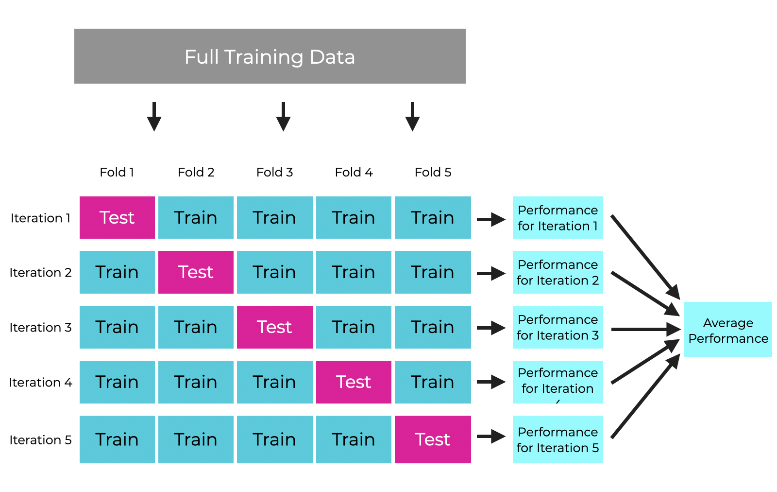
Cross-Validation – Making Metrics Reliable
Why Use It?
Reduces variance due to random splits.
Prevents overfitting to a particular train/test split.
Helps in hyperparameter tuning and model selection.
Image source:https://sharpsight.ai/blog/cross-validation-explained/

Slide 48
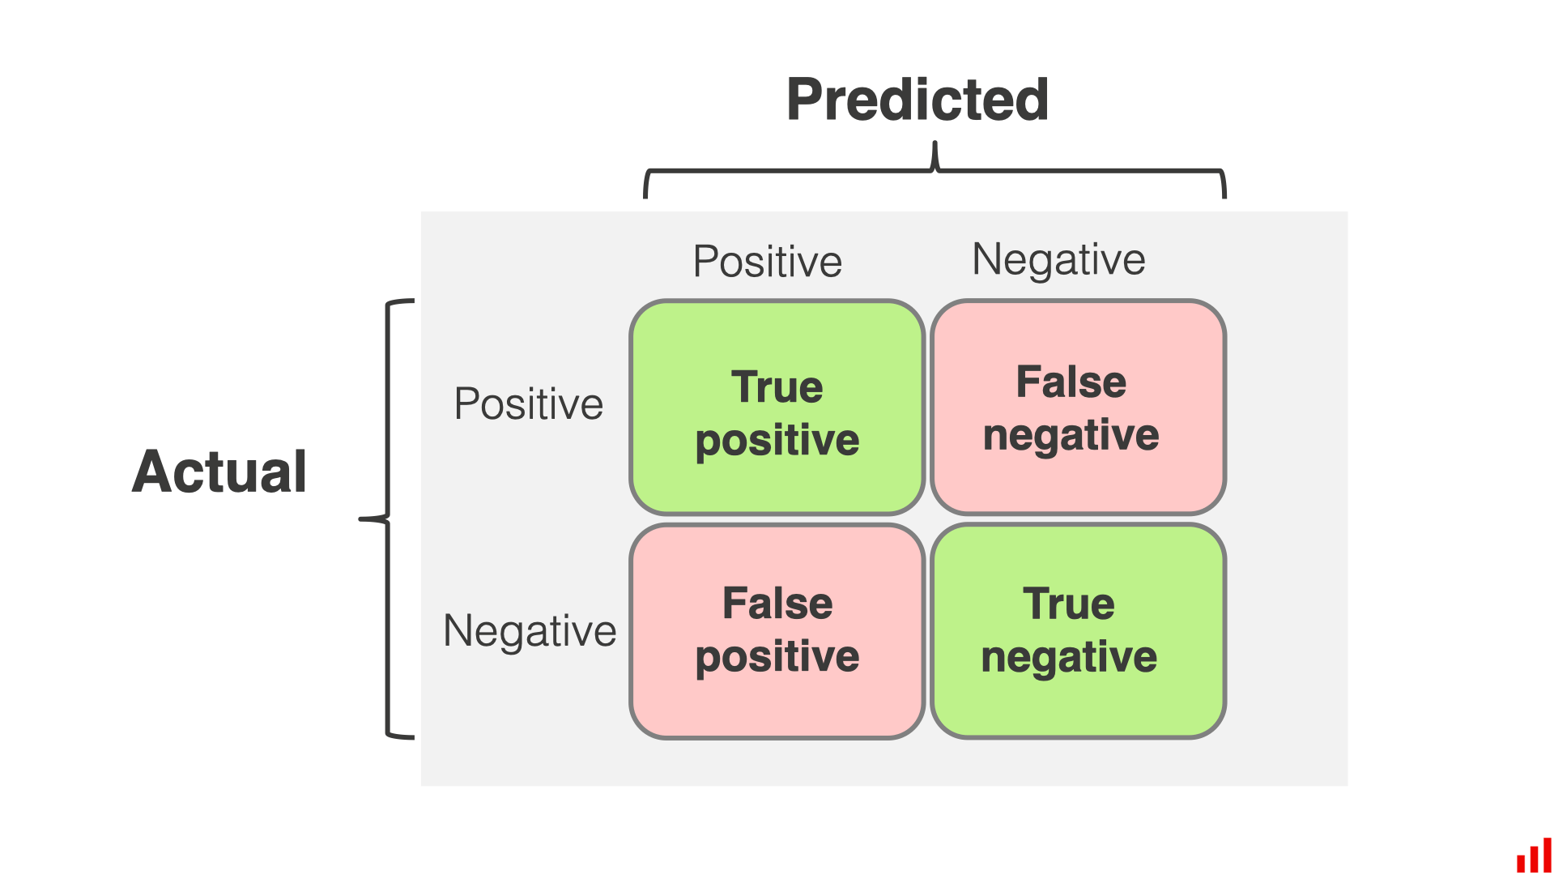
Confusion Matrix – Understanding Classification Behavior
A confusion matrix is a performance measurement tool for classification models. It compares actual labels with predicted labels to help you understand where the model is making correct or incorrect decisions.
Confusion Matrix Layout:
Image source: https://www.evidentlyai.com/classification-metrics/confusion-matrix

Slide 49
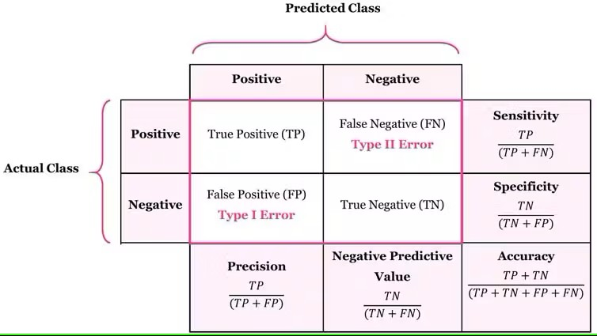
Confusion Matrix - Formulas
Image source: https://encord.com/glossary/confusion-matrix/

Slide 50
Explanation of Terms:
True Positive (TP): The model correctly predicted the positive class. Example: A test correctly identifies a person as having COVID-19.
False Positive (FP) (Type I Error): The model incorrectly predicted positive for a negative case. Example: A test says someone has COVID-19, but they are actually healthy.
False Negative (FN) (Type II Error): The model missed a positive case by predicting it as negative. Example: A test says someone is healthy, but they actually have COVID-19.
True Negative (TN): The model correctly predicted the negative class. 🧪 Example: A test correctly identifies a healthy person as not having COVID-19.

Slide 51
Deployment and Monitoring

Slide 52
YouTube Spam Detection System
Imagine this situation:
You are a machine learning engineer at YouTube, and you just developed a brilliant model to detect spam comments on videos. It performs with 99% accuracy on your test dataset.
Now you deploy it…
But suddenly:
Real comments are being wrongly removed.
Spam comments are slipping through.
System crashes on high-traffic videos.
A model update causes unexpected behavior.

Slide 53
Questions
What do you think went wrong even though the model was accurate during training?
How can you ensure the model continues to work well after it is deployed?
What steps would you take if the model starts behaving differently a month after deployment?
Do you think deploying a model is the end of the process or just the beginning? Why?
If YouTube adds new types of content (e.g., YouTube Shorts or Podcasts), do you think the same spam model would still work well?

Slide 54

These questions show why model deployment and monitoring are essential.
A model that performs well in the lab may fail in the real world.
So let’s explore how companies successfully deploy machine learning models — and what they do to monitor them afterward.
Solution

Slide 55
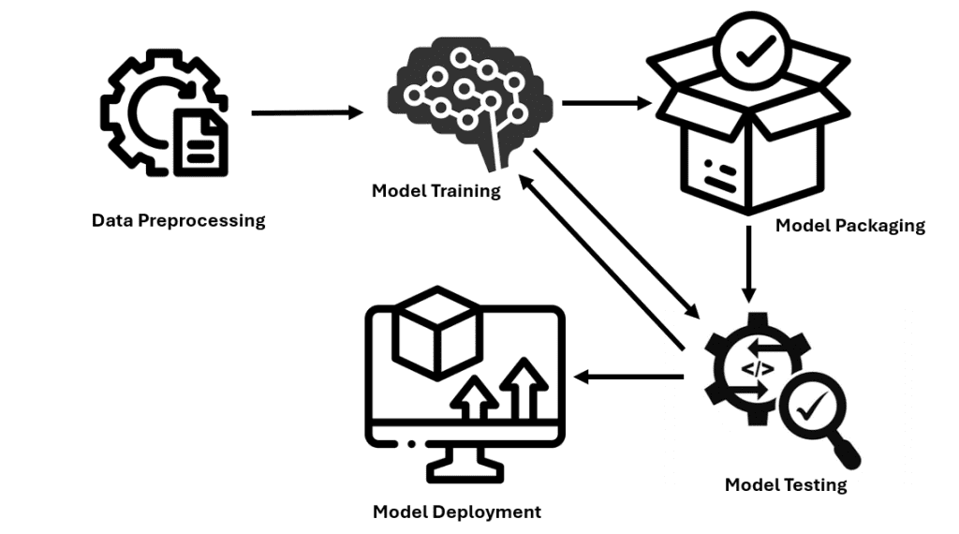
Model Deployment Options – Batch vs. Real-Time
What is Model Deployment?
Model deployment is the process of integrating a machine learning model into a production environment where it can start making predictions on live data. It’s where your model transitions from a training notebook to real-world impact.
Image source: https://www.kdnuggets.com/deploying-machine-learning-models-a-step-by-step-tutorial

Slide 56
Deployment Types
Batch Deployment
Real-Time Deployment
Definition: Model processes data in bulk at scheduled intervals (e.g., nightly, weekly).
When to use: When immediate predictions are not required.
Cost-effective and suitable for large data.
Example:
A retail company predicts weekly inventory needs every Sunday night based on last week's data.
A hospital processes all patient risk assessments every morning before doctors' rounds.
Definition: Model is deployed as an API/microservice, making instant predictions on new incoming data.
When to use: In time-sensitive scenarios where latency matters.
Requires high availability, auto-scaling, and low latency infrastructure.
Example:
Fraud detection system that blocks suspicious credit card transactions instantly.
Voice assistant (e.g., Alexa or Siri) giving a response in real time.

Slide 57
Model Versioning – Tracking Changes Across Models
Why Model Versioning Matters
Just like software, ML models undergo updates. Model versioning is tracking and managing multiple versions of your model and its dependencies (data, code, metrics) for reproducibility, auditability, and rollback.
Common Scenario:
You deployed a model in January. After retraining it in March with more data and better hyperparameters, the new version performs better on validation — but in production, results worsen. Without versioning, you can't roll back or trace what went wrong.

Slide 58
Model Versioning – Tracking Changes Across Models
Tools for Model Versioning
Versioning Includes
Model weights/parameters
Training data version
Preprocessing steps
Evaluation metrics
Hyperparameters used
Tool | Use Case
MLflow | Track models, experiments, parameters
DVC | Git-like version control for data/models
LakeFS | Version control for large datasets
Weights & Biases | Track experiments and model lineage

Slide 59
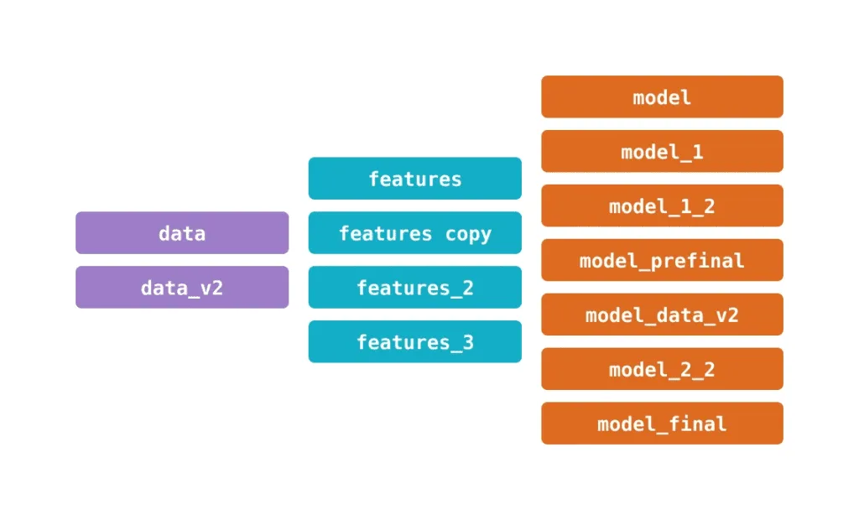
Model Versioning – Tracking Changes Across Models
Image source: https://lakefs.io/blog/model-versioning/

Slide 60
Model Monitoring – Performance and Drift Detection
Why Monitoring is Critical:
Training performance ≠ real-world performance. Over time, changes in user behavior,
environment, or incoming data can cause model degradation.
Monitoring ensures that your model:
Performs consistently.
Detects drift in input data or concept.
Triggers retraining or rollback when needed.

Slide 61
Model Monitoring – Performance and Drift Detection
What to Monitor?
Aspect | Description
Performance | Accuracy, Precision, F1, AUC, Latency
Data Drift | Shift in input feature distribution
Concept Drift | Change in relationship between features and target
Model Output | Frequency, confidence levels, error rates

Slide 62
Model Monitoring – Performance and Drift Detection
Best Practices:
Set performance thresholds and alerts.
Log predictions and ground truth regularly.
Schedule model evaluations monthly/weekly.
Use automated retraining pipelines on detected drift.

Slide 63
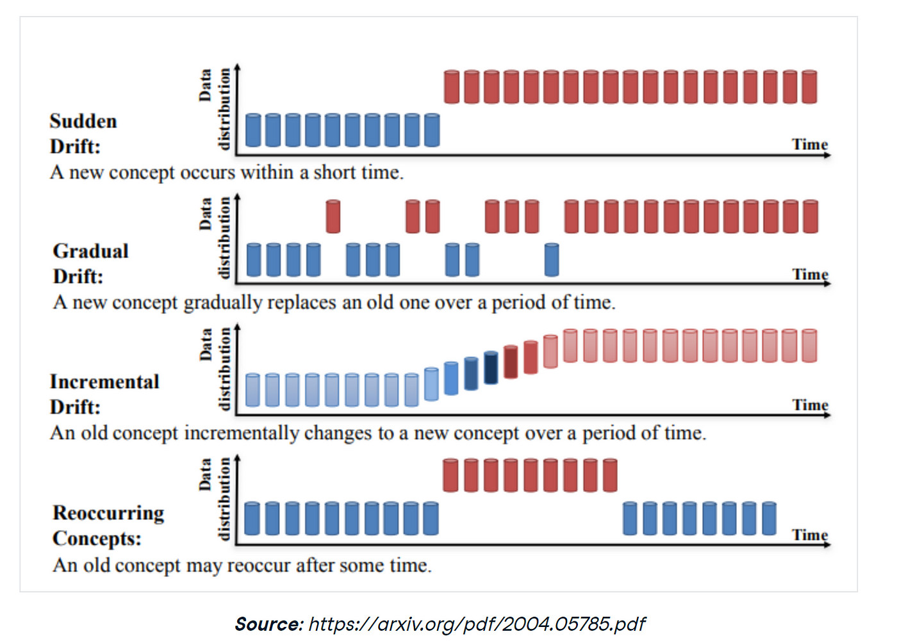
Types of Data Drifts

Slide 64
Activity — Example from Airbnb
Case Study: Airbnb Price Prediction Model
Airbnb built a model to recommend competitive pricing for hosts based on location, seasonality, demand, and more. After deployment, Lets suppose hosts reported:
Wild price fluctuations,
Lower bookings in some areas,

Slide 65

Activity — Example from Airbnb
Instructions:
Step 1 – Read this scenario (add to a sticky note or card in Miro):
“Airbnb has deployed a price prediction model. After deployment, they notice strange pricing behavior. Some cities have unusually high prices, and bookings drop.”
Step 2 – Collaborate in teams and answer the following questions on Miro:
What deployment mistakes might have caused this?
What could Airbnb have done to monitor the model better?
How would you fix the issue without taking the system offline?
What metrics should Airbnb continuously monitor?
Step 3 – Present your findings
Each team presents a quick action plan based on their sticky notes in Miro.

Slide 66
CI/CD for ML

Slide 67
Brain Teaser
Imagine you're working as an ML engineer at Amazon.
You've trained a product recommendation model and deployed it last week.
Your team makes changes every day—new data, new features, and even tweaks to the model architecture.

Slide 68
Brain Teaser
If the data changes daily, how do you ensure the model still performs well after each update?
What if a new model version suddenly recommends irrelevant products? How would you detect and roll it back?
In software engineering, we test code with unit tests. How would you test a machine learning model before deploying?
How would you track which version of the model and data is live in production?
Suppose multiple team members are working on different parts of the ML pipeline (data cleaning, training, monitoring).How do you collaborate without breaking the system?

Slide 69
What is CI/CD in MLOps and Why Does It Matter?
MLOps applies software engineering practices like DevOps to machine learning workflows, helping teams build, deploy, and maintain ML models efficiently.
Continuous Integration (CI) means automatically building and testing your ML pipeline components every time new code is added. This catches errors early and ensures your pipeline remains healthy.
Continuous Delivery/Deployment (CD) automates deploying these validated pipeline components and trained models to production or testing environments without manual intervention.
Why?
Data and requirements change rapidly.
You want to experiment and iterate fast without breaking your production system.
Automation reduces human error and speeds up releases.
Example:
Imagine your team develops a model to detect fraudulent transactions. Every night, new transaction data comes in. With CI/CD, your team’s updated fraud model can be automatically retrained, tested, and deployed, keeping fraud detection up to date without manual effort.

Slide 70
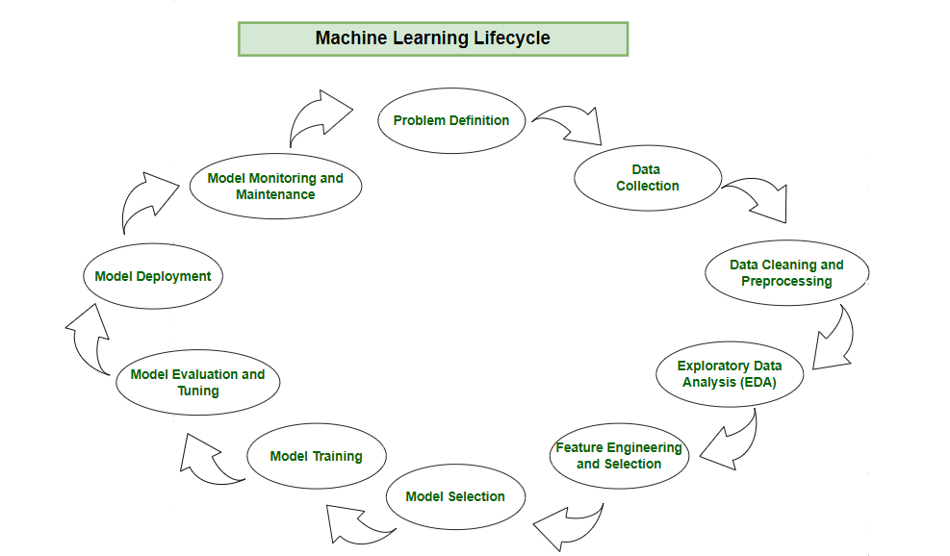
ML Life Cycle
Image source: https://www.geeksforgeeks.org/machine-learning-lifecycle//

Slide 71
Core Components of a CI/CD Pipeline for ML
To automate your ML lifecycle effectively, you need these key components:
Source Control (e.g., GitHub, GitLab)
Where your code, configs, and sometimes data snapshots live.
Enables version tracking and collaboration.
Test & Build Services (e.g., Jenkins, GitHub Actions)
Automatically run tests on your feature engineering code and model training scripts.
Build artifacts like container images or packages for deployment.
Model Registry (e.g., MLflow, Vertex AI Model Registry)
Stores, versions, and tracks your trained models.
Feature Store
Central repository for reusable, consistent feature data, avoiding discrepancies between training and serving.
Pipeline Orchestrator (e.g., Kubeflow Pipelines, TFX)
Automates running your ML workflow steps (data processing, training, evaluation, deployment).
Deployment Services
Infrastructure to serve your models via APIs, e.g., cloud platforms or Kubernetes.

Slide 72
Core Components of a CI/CD Pipeline for ML
Source Control
CI Build
Model Registry & Feature Store
Orchestrator
Deployment
Monitoring

Slide 73
How the CI/CD Pipeline Works in Practice
To succeed with CI/CD in ML, keep these best practices in mind:
Unit test your feature engineering logic to catch bugs early (e.g., check if categorical encoding works as intended).
Test model training stability: Make sure training converges and doesn’t produce invalid results like NaNs or infinite losses.
Validate API inputs/outputs: When deploying new models, test if the prediction API accepts expected inputs and returns valid predictions.
Progressive Deployment: Use environments like development → staging → production with manual approvals to avoid risky immediate releases.
Performance & Load Testing: Check that your prediction service can handle expected request volumes with acceptable latency.
Model Validation: Only deploy models meeting business and accuracy targets.

Slide 74
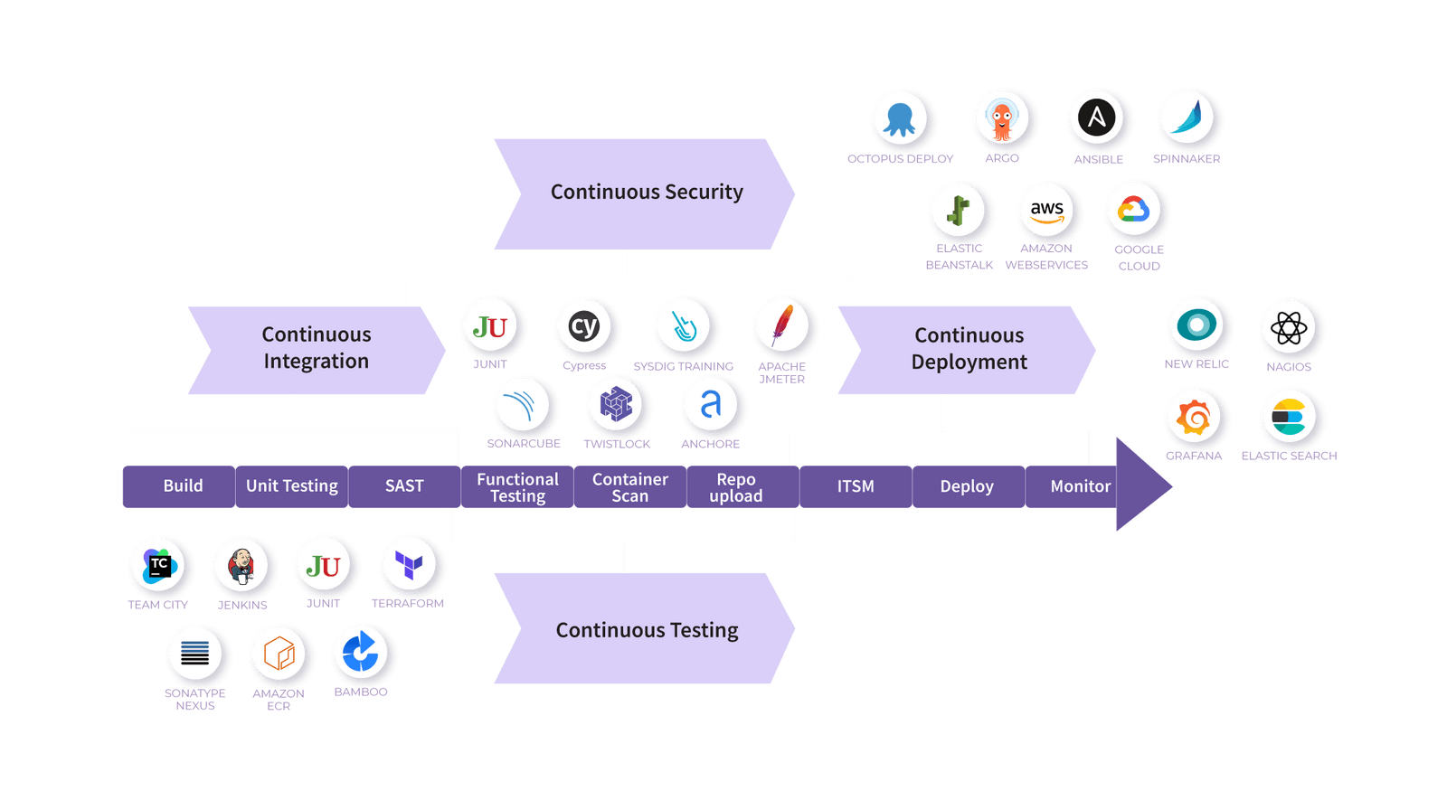
How the CI/CD Pipeline Works in Practice?
Image source: https://www.opsera.io/blog/all-you-need-to-know-about-ci-cd-pipeline

